Slide 1
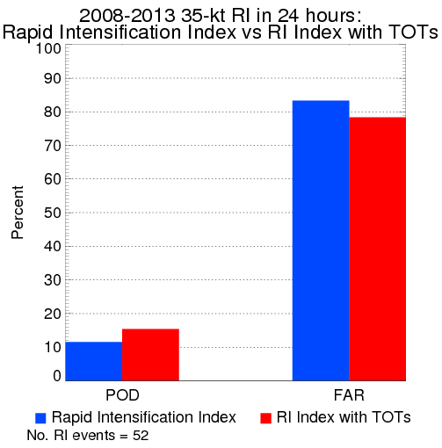
Identifying Overshooting Tops in Tropical Convection
GOES infrared brightness temperatures (BT) are used to objectively identify overshooting tops in tropical convection (TOTs). TOT heights are assigned using TOT BT and NWP profiles.
Useful for aviation such as aircraft field campaigns to help guide missions as part of hazard avoidance.
FY16-17 R3 project will examine TOTs as a potential predictor in multi-parameter TC genesis and rapid intensification forecast models, as well as investigate if TOTs are correlated with lightning.
The TOT product will continue to be evaluated by NHC/TAFB in the GOES-R Proving Ground exercise, as well as in ongoing aircraft field campaigns.
TOTs (purple squares) are identified in the eyewall of Category 4 Hurricane Joaquin as the WB-57 aircraft flies over.
TOTs have shown to marginally improve TC RI forecasts when added as a parameter to a multi-predictor model.
Help identify areas of tropical convection for hazard avoidance and tropical cyclone forecasts
C. Velden (UW-CIMSS), S. Griffin (UW-CIMSS)

